Slide 1
High dimensional analysis of chemokine receptor expression on encephalitogenic CD4+ T cells in EAE
With RNA velocity for Th cell trajectories…

Slide 2
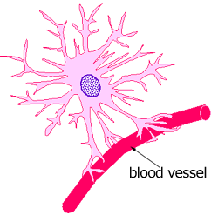
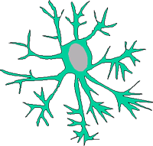

Immunopathogenesis of EAE
CNS
Antigens
BBB
Microglia
T_{reg}
B
Choroid plexus
DC
Th17
Th17
CD4
CD4
CD4
T_{reg}
Neuron
Th1
IL-17A
IL-17F
GM-CSF
IL-21
IL-22
TNFα
CXCL8
CD4
CD4
IL-10
TGFβ
Monocyte
CD4
CD4
Blood Brain Barrier
Inflamed Blood-Brain Barrier
CD8
CD8
CD8
Myelin
Sheath
CD8
IFNγ
CD4
CD8
CD4
CD8
Th17
Th1
Myelin
Sheath
CD8
Inflamed Blood-Brain Barrier
CD8
CD8
Oligodendrocyte
Cytotoxic
CD4
Th1
Neutrophil
B
B
T_{reg}
Inflammatory
Mediators
B
B
Skin
Lymph nodes / Spleen
Blood
Central Nervous System
Blood
Cell migration into the CNS is a key step in pathogenesis of the disease

Slide 3
The Chemokine Gene Superfamily
CXCR1 CXCL6, CXCL7, CXCL8
CXCR2 CXCL1, CXCL2, CXCL3, CXCL5, CXCL6, CXCL7, CXCL8
CXCR3 CXCL9, CXCL10, CXCL11, CXCL13
CXCR4 CXCL12
CXCR5 CXCL13
CXCR6 CXCL16
CCR1 CCL3, CCL5, CCL15, CCL16, CCL23
CCR2 CCL2, CCL7, CCL8, CCL13, CCL16
CCR3 CCL5, CCL7, CCL11, CCL15, CCL24, CCL28
CCR4 CCL17, CCL22
CCR5 CCL3, CCL4, CCL5, CCL8, CCL11, CCL16
CCR6 CCL20
CCR7 CCL19, CCL21
CCR8 CCL1, CCL18
CCR9 CCL25
CCR10 CCL27, CCL28
CXC chemokines
CC chemokines
ACKR1 CCL2, CCL5, CCL11, CCL13, CCL14,
CCL17, CXCL5, CXCL6, CXCL8, CXCL11
ACKR2 CCL2, CCL3, CCL4, CCL5, CCL7, CCL8,
CCL11, CCL12, CCL13, CCL17, CCL22
ACKR3 CXCL11, CXCL12
ACKR4 CCL19, CCL21, CCL25
XCR1 XCL1, XCL2
C chemokine
Atypical regulators
CX3CR1 CX3CL1
CX3C chemokine

Slide 4
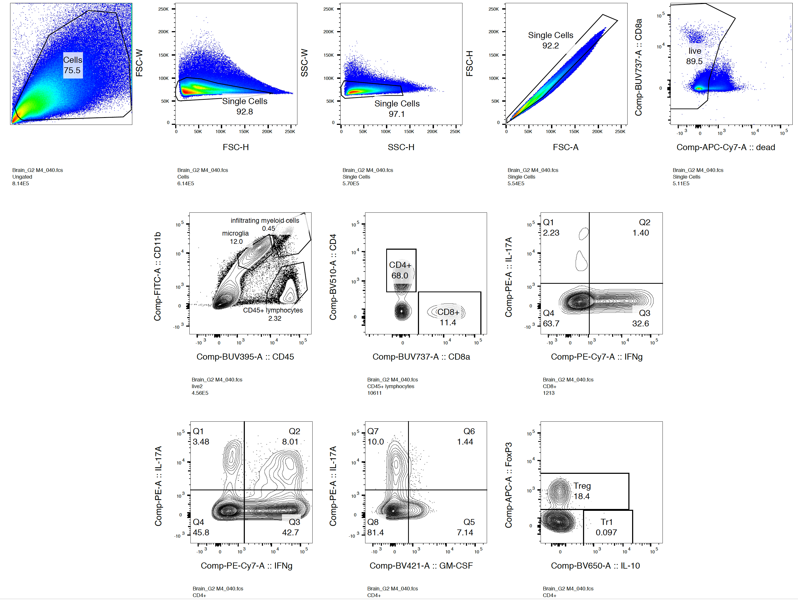
Flow cytometry of brain cell suspension from mouse with clinical EAE score of 3 (full hind limb paralysis)

Slide 5
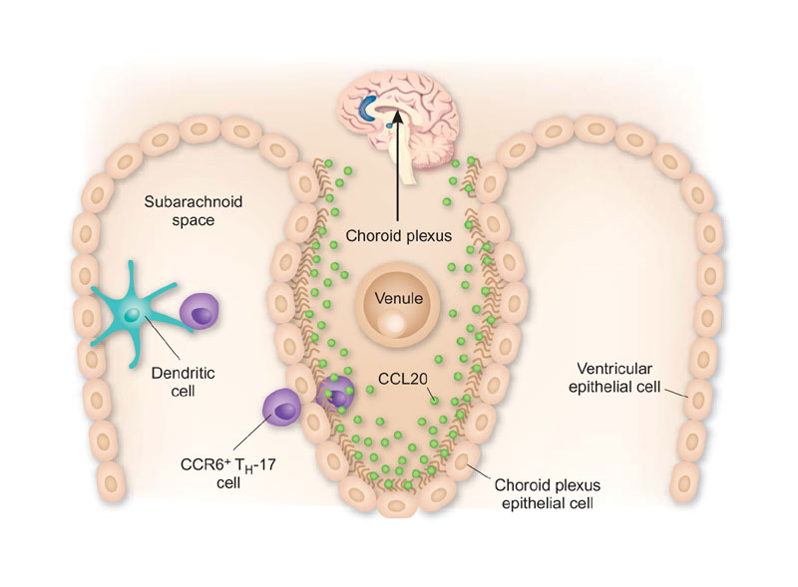
Trafficking of Th17 cells to the CNS
Th17 cells characteristically express the chemokine receptor CCR6
CCR6 sole chemokine ligand is CCL20 – mainly expressed at epithelial surfaces (including choroid plexus)
Th17 migration across choroid plexus epithelium dependent on CCR6/CCL20 (Reboldi et al., 2009 Nature Immunology).
Axtell and Steinman. Nature Immunology. 2009. 10(5):453-5.

Slide 6
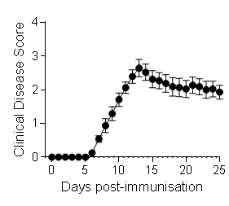
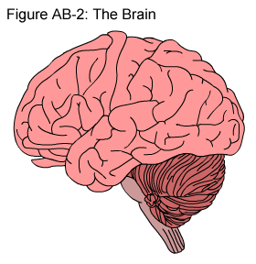

Trafficking of Th17 cells to the CNS in EAE
What mechanisms mediate CCR6-independent 2nd phase of Th17 recruitment to the inflamed CNS?
Is there a chemokine axis used by Th17 cells but not Tregs for migration to the inflamed CNS?
UNINFLAMED CNS
CCR6-driven Th17 recruitment (1st wave) – disease initiation
INFLAMED CNS
CCR6-independent Th17 recruitment (2nd wave) – disease progression
CCR6
CCR6
Treg
CCR6
CCR6
Th17
Th17
Esplugues et al., Nature 2011
Villares et al., EJI 2009
Elhofy et al., J Neuroimmunol 2009
Reboldi et al., Nature Immunol 2009

Slide 7
Th17 cells express CCR2 in addition to CCR6 in EAE
Gating on Th17 cells
Gating on T cells in spleen on d10 of EAE immunisation
Kara et al., CCR2 defines in vivo homing and development of IL-23-driven GM-CSF-producing Th17 cells. Nature Communications. 2015; 6:8644.

Slide 8
T cell intrinsic role for CCR2 in EAE
T-cell specific CCR2 KO bone marrow chimeras (mice in which the only the T cells lack CCR2)
80% B6.Tcra^{-/-}
+
20% B6 (WT),
20% B6.Ccr6^{-/-},
20% B6.Ccr2^{-/-} or
20% B6.Ccr6^{-/-}.Ccr2^{-/-}
1000 Rad
B6.Ly5.1
i.v.
Kara et al., CCR2 defines in vivo homing and development of IL-23-driven GM-CSF-producing Th17 cells. Nature Communications. 2015; 6:8644.

Slide 9
CCR6 and CCR2 control Th17 recruitment to the CNS at distinct phases of EAE
UNINFLAMED CNS
CCR6-driven Th17 recruitment (1st wave) – disease initiation
INFLAMED CNS
CCR2-dependent Th17 recruitment (2nd wave) – disease progression
Kara et al., CCR2 defines in vivo homing and development of IL-23-driven GM-CSF-producing Th17 cells. Nature Communications. 2015; 6:8644.

Slide 10
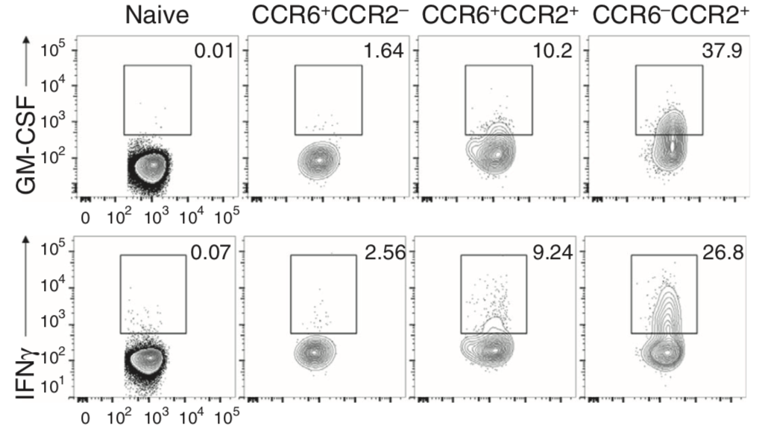
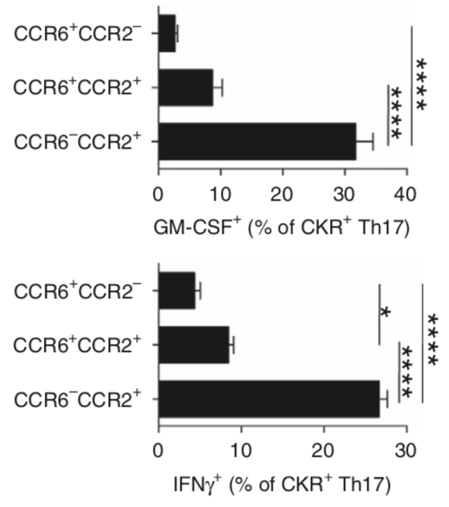
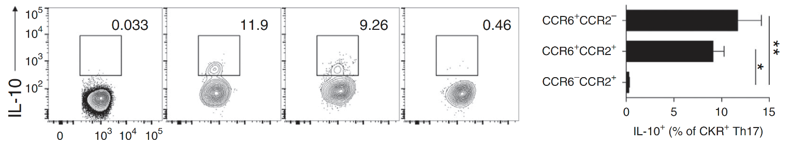

The CCR2⁺CCR6⁻ profile enriches for pathogenic Th17 cells
CD4 T cells from PBMCs from MS patients
IL-10
Kara et al., CCR2 defines in vivo homing and development of IL-23-driven GM-CSF-producing Th17 cells. Nature Communications. 2015; 6:8644.

Slide 11
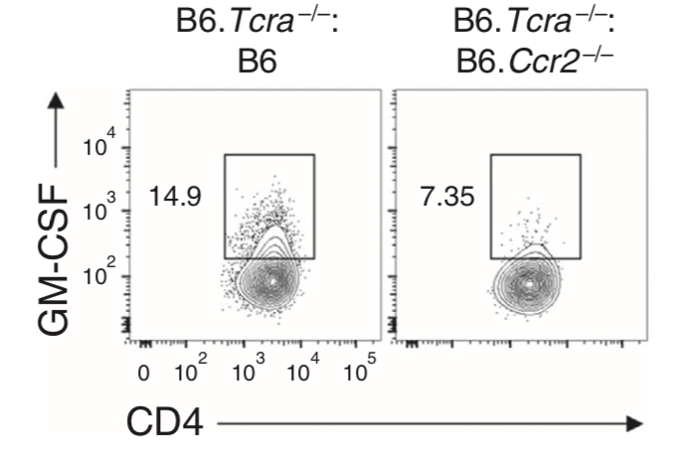
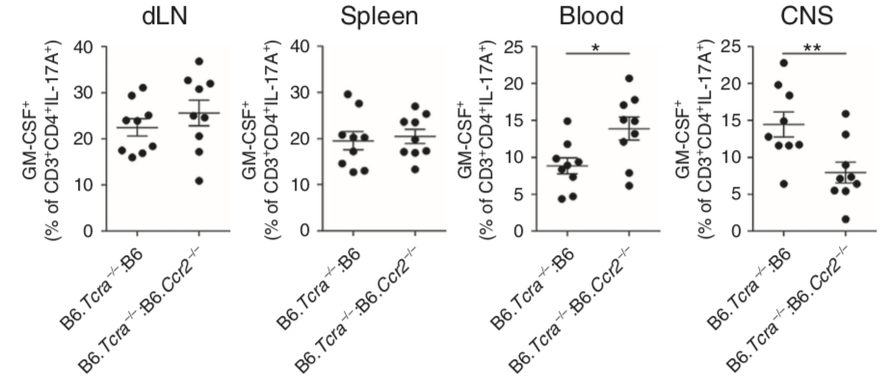
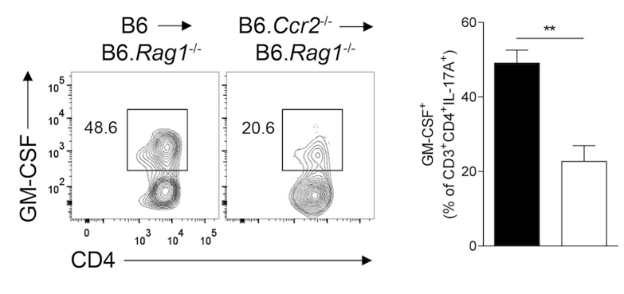
GM-CSF-producing Th17 cells utilise CCR2 to enter the CNS in EAE
T-cell specific bone marrow chimeras
1000 Rad
80% B6.Tcra^{-/-}
+
20% B6,
or
20% B6.Ccr2^{-/-}
i.v.
B6.Ly5.1
Immunise for EAE
Analyse GM-CSF⁺ T cells in the CNS
Rag1^{-/-} mouse model
i.v.
Immunise for EAE
Naïve CD4⁺ T cells from either
B6 (WT) or B6.Ccr2^{-/-}
Rag1^{-/-}
Kara et al., CCR2 defines in vivo homing and development of IL-23-driven GM-CSF-producing Th17 cells. Nature Communications. 2015; 6:8644.

Slide 12
IL-17
GM-CSF
IL-17
IFNγ
IL-6
TGFβ
CCR6
CCR2
IL-23
IL-1
TNF
IFNγ
CD4
RORγt
T-bet
RORγt
Th17
Pathogenic Th17
CCR2⁺CCR6⁻
What additional trafficking mechanisms account for CCR2-independent recruitment of pathogenic Th17 cells?
Can a more specific trafficking signature for these cells be identified?

Slide 13
RNAseq of Pathogenic Th17 cells
Unpublished

Slide 14
Plan
Purify CD4+ T cells from the CNS (and LN and spleen if can use MOG tetramer) of EAE mice (3 timepoints: day 10, 15, 20. 9 samples in total, 3 biological replicates for each sample pooled?)
Label with barcoded anti-CKR Ab panel
10X genomics single cell 3’ v3 protocol
Illumina Seq for mRNA reads and surface CKR protein expression profiles
Clustering
RNA velocity analysis

Slide 15
Step 1: Panel design
Description | Clone | TotalSeq B
CCR1 | S15040E | N
CCR2 | SA203G11 | Y
CCR3 | J073E5 | N
CCR4 | 2G12 | Y
CCR5 | HM-CCR5 | N
CCR6 | 29-2L17 | Y
CCR7 | 4B12 | Y
CCR8 | SA214G2 | Y
CCR9 | CW-1.2 | Y
CXCR2 | SA044G4 | Y
CXCR3 | CXCR3-173 | Y
CXCR4 | L276F12 | Y
CXCR5 | L138D7 | Y
CXCR6 | SA051D1 | N
CX3CR1 | SA011F11 | Y
XCR1 | ZET | Y
CXCR6 and CCR5 custom labelled.
For timecourse/different tissues:
Each timepoint each sample given a unique Cell hash for TotalSeq B too.

Slide 16
Step 2: Optimise anti-CKR panel
Obtain the available barcoded mAbs , isotypes and PE-conjugated clones. - DONE
Totalseq-B. Need to obtain: anti-CCR5 and anti-CXCR6 as custom labels for TotalSeq-B. -DONE
MC-21 anti-CCR2 clone for labelling? (will test SA203G11 vs MC-21 first) –In progress.
Titrate – use PE-conjugated version of each clone to do this. - Underway
Test that barcoded mAb clones not blocked by cell purification method

Slide 17
Step 3: Optimise purification of Ag-specific T cells from EAE mice
Flow sorting MOG tetramer-PE+ CD4+ CD3+ live cells (testing)
Or anti-CD4 microbeads to pull out total CD4 T cells from CNS only
Test both in comparison for speed, viability and purity?
Timing of purification and fastest prep with highest viability / purity for optimal workflow

Slide 18
Step 4: Initial pilot experiment
1 timepoint: peak EAE CNS – 3 mice pooled?
No cell hashing required?
Luciano Martoletti will run the Chromium single cell 3’ GEM and sequencing
Bioinformatics analysis?

Slide 19
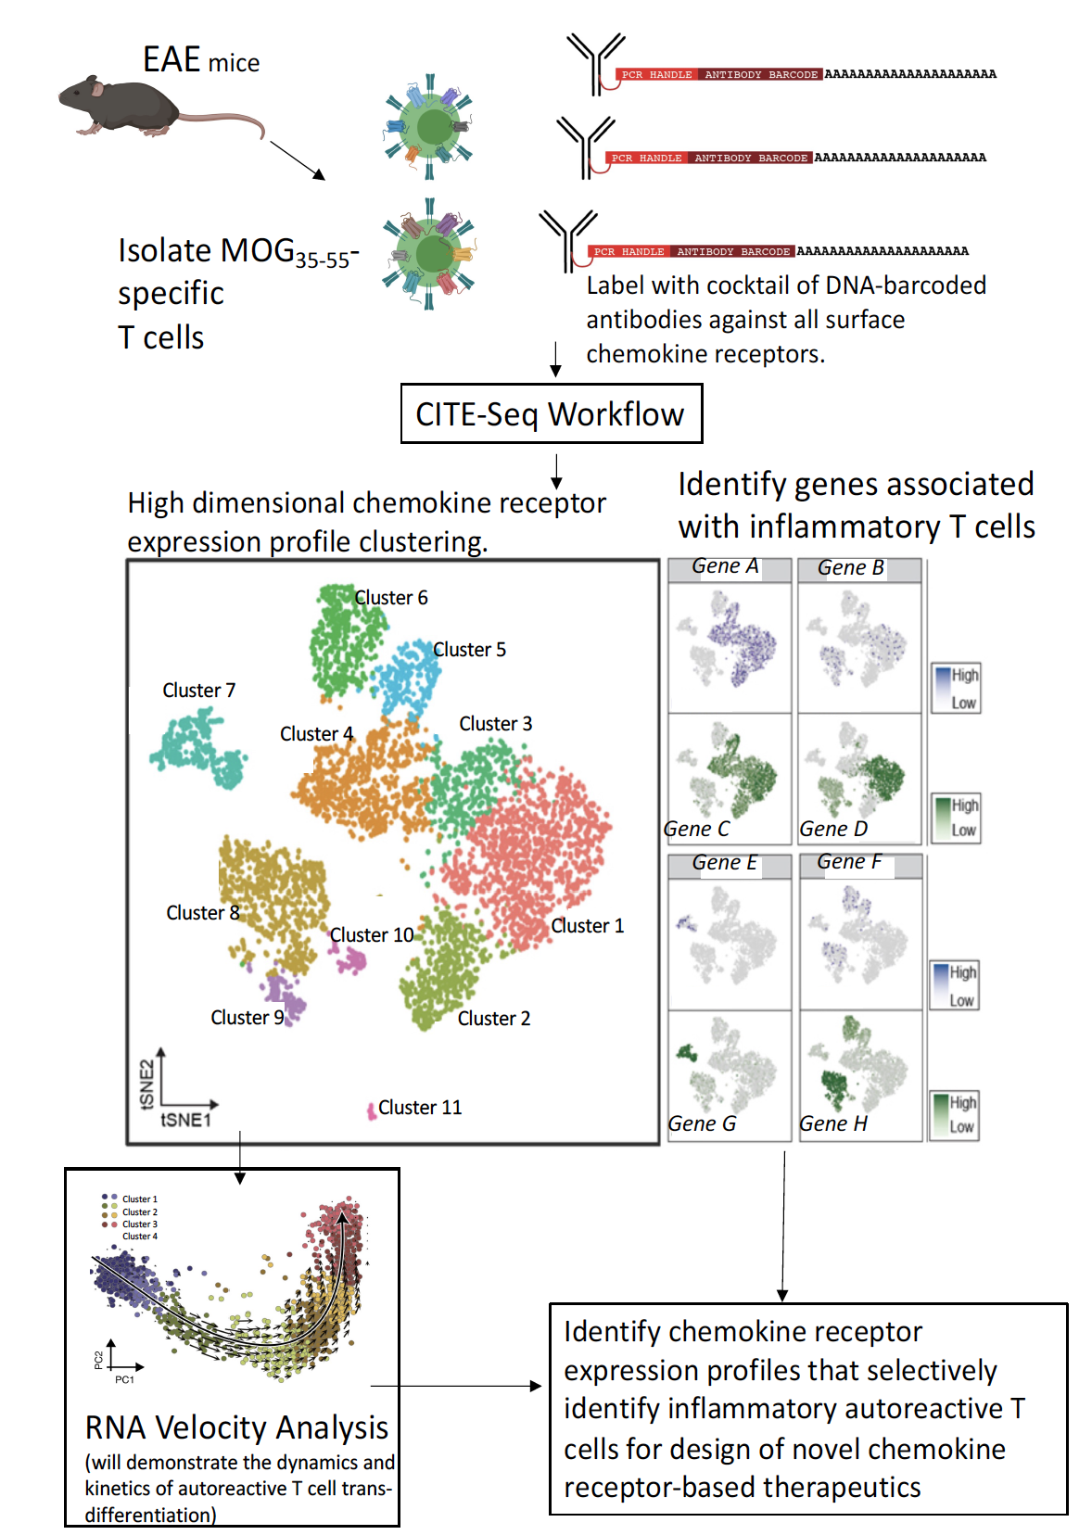
Bioinformatics…

